Slide 1
ENVIRONMENTAL IMPACT ASSESSMENT OF KOCHI METRO
Aluva-Petta

Slide 2
CIVIL ENGINEERING DEPARTMENT
VISION
“Building Professionally Competent and Motivated Engineers in the Arena of Civil Engineering with High Professional Ethics.”
MISSION
To promote a better teaching learning process through academically proficient faculties, full fledged laboratories and excellent infrastructure facilities.
To equip the graduates with knowledge, research and practical skills in modern construction practices and techniques.
To inculcate knowledge of sustainability in various domains of Civil Engineering.
To nurture Civil Engineers into ethically strong and responsible leaders to address global challenges through quality education.
VJCET VAZHAKULAM

Slide 3
PROGRAM EDUCATIONAL OBJECTIVES
Our Graduates
Shall tackle the multiple responsibilities of analysis, design and construction of traditional and modern systems in compliance with various codes of practices and to meet the current technical challenges.
Shall be proficient in the use of relevant software packages for planning, designing, scheduling, executing and controlling of civil engineering projects, with an urge for life-long learning.
Shall function effectively with individual capabilities as well as with a collective strength as a professional team with good communication skills.
VJCET VAZHAKULAM

Slide 4
PROGRAMME SPECIFIC OUTCOMES
CIVIL ENGINEERING DEPARTMENT
Ability to utilize civil engineering principles and software that are appropriate to solve technical problems, prepare design and construction documents ,create structural systems; produce drawings, reports and quantity estimates related to the Civil Engineering domain.
Ability to utilize modern surveying methods for land measurement and/or construction layout and to conduct standardized field /laboratory tests related to Civil Engineering.
VJCET VAZHAKULAM

Slide 5

OVERVIEW
1.INTRODUCTION
2.KOCHI METRO
3.OBJECTIVES OF STUDY
4.METRO ROUTE : ALUVA –PETTA
5.ENVIRONMENTAL BASELINE DATA
6.SOCIO-ECONOMIC STUDY (ALUVA-PULINCHODU)
7.POSITIVE ENVIRONMENTAL IMPACTS
8.NEGATIVE ENVIRONMENTAL IMPACTS
9.ENVIRONMENTAL MANAGEMENT PLAN
10.ENVIRONMENTAL MONITORING PLAN
11.WITH AND WITHOUT METRO SCENARIO
12.CONCLUSION
13.REFERENCES

Slide 6
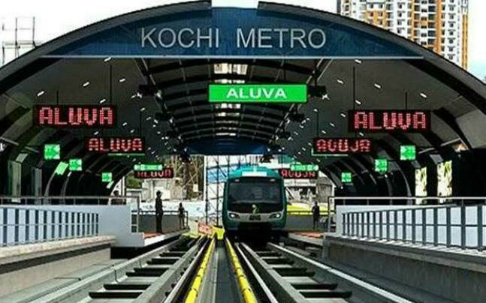
EIA OF KOCHI METRO
INTRODUCTION
●Kochi Metro Rail Project-An initiative by Kerala Government.
●Span of 25km with 22 stations from Aluva to Petta and maintenance depot at Muttom.
●Environmental Impact Assessment (EIA) study-to document the assessments of environmental impacts associated with development of Kochi metro.
●Deals with ►Environmental factors
►Socio-Economic factors
VJCET VAZHAKULAM

Slide 7
EIA OF KOCHI METRO
Kochi metro
●Fastest completed metro project in India.
►Opened to public within three years and ten months.
●First metro in country which connects rail,road and water transport facilities.
●The first phase is being set up at an estimated cost of 51.81 billion.
●Former PM Dr Manmohan Singh laid the foundation stone for the Kochi Metro rail project in 2012.
VJCET VAZHAKULAM

Slide 8
EIA OF KOCHI METRO
●Construction work was started in June 2013.
●2 phases ►1st phase-Aluva to Petta
►2nd phase-Petta to Thripoonithara
●13.4 km section of the line from Aluva to Palarivattom was opened to public on 17 June 2017 by PM Narendra Modi
●Kochi metro also includes the technology for driverless trains and is hoping to implement this in the near future.
VJCET VAZHAKULAM

Slide 9
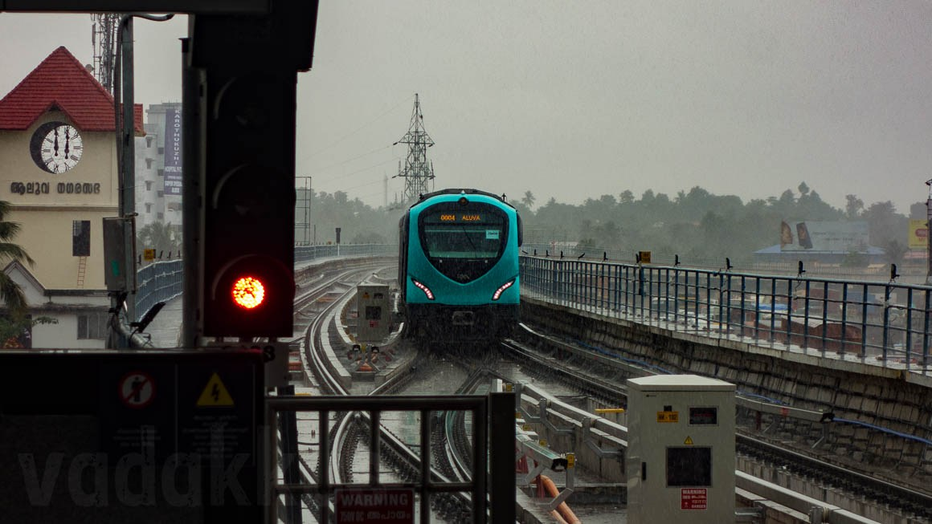
EIA OF KOCHI METRO
Objectives of study
●To conduct baseline environmental resources studies of the area.
►Secondary data
►Previous studies
●To analyse environmental impacts during 3 stages
►Before construction
►During construction
►Post construction
●To propose measures to mitigate
the environmental impacts
VJCET VAZHAKULAM

Slide 10
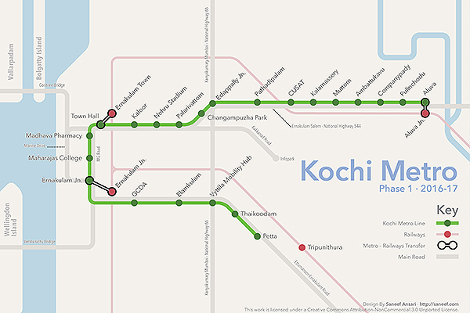
EIA OF KOCHI METRO
Metro route:Aluva-petta
VJCET VAZHAKULAM

Slide 11
EIA OF KOCHI METRO
Environmental baseline data
●To ascertain existed baseline condition-before Metro construction.
●Data from field studies – April to May 2005.
♦LOCATION AND PHYSIOGRAPHY
►Project location – 1.2m above sea level
►Project route – level terrain with little undulations
♦AIR QUALITY
►Monitoring was done at 8 locations for SPM,RPM,SO2 & Nox.
►Compared with National Ambient Air Quality Standards data (NAAQS)
►RPM & NOx - exceeded at few stations
►SO2 & SPM – within limits
►Overall air quality – Moderate to very unhealthy
►As per AQI – value ranges from 51-300
VJCET VAZHAKULAM

Slide 12
EIA OF KOCHI METRO
♦WATER AND SOIL
►Analysis for chemical and biological parameters
►Datas were compared with Class SW V water and was within limits
►Class SW V waters-Primary Water Quality criteria for Navigational and Controlled Waste Disposal
Analytical result of surface water samples
Parameter | Observation | Standard value
pH | 6.23 | 6.0-9.0
Dissolved Oxygen | 3.93 mg/l | 3.0 mg/l (min)
Colour and Odour | Negligible | No colour and Odour
Sludge deposit | Nil | 10 mg/l
Solid Refuse | Negligible | 10 mg/l
Floating Solids | Occasional | Minimum
Oil and Grease | Not Defected | 10 mg/l
Scum | Nil | 10 mg/l
VJCET VAZHAKULAM

Slide 13
EIA OF KOCHI METRO
♦NOISE
►Studies at 8 stations at 2.0m away from source as per standard practice.
►Referred with Ambient Air Quality Standards.
►Results found to be slightly greater than permissible levels of 65 dBA on day time & 55dB on night for commercial areas.
►Average data - During day (52-72dBA)
- During night ( 40-65dBA)
♦SEISMICITY
►Proposed area falls under Zone III
►As per IMD seismic zones
SEISMIC ZONE | INTENSITY
Zone V | Very High
Zone IV | Severe
Zone III | Moderate
Zone II | Low
VJCET VAZHAKULAM

Slide 14
EIA OF KOCHI METRO
Socio-economic study
(aLUVa-pulinchodu)
●Studies on demographic structure of area,basic amneties,health status,
people,etc..
●Average literacy rate of Ernakulam district-92.35%.
● District consists about 50% of hindu families,72% general people,37%of people between 36-60 yrs of age.
●Level of annual income –between Rs 50,000 and Rs 1,00,000 for 1/3rd of population.
●Houses form majority of structures.
●Most houses-less than 20 yrs old,20% houses between 20 and 30 yrs.
VJCET VAZHAKULAM

Slide 15
EIA OF KOCHI METRO
●Project route
►Composes of large no.of major,medium and small scale
industries.
►No important historical monuments
●Minimum dislocation as metro runs along median of road.
●Major source of water supply
►Municipal supply
►Dug wells
●Solid waste removal- municipality(on regular basis)
●Septic tanks-predominant method of sanitation
VJCET VAZHAKULAM

Slide 16
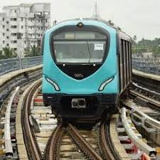
EIA OF KOCHI METRO
Positive environmental impacts
●Reduction in traffic congestion
●Quick service and safety
●Less fuel consumption
●Reduction in air pollution
●Reduction in noise level
●Better roads
●Employment opportunities
VJCET VAZHAKULAM

Slide 17
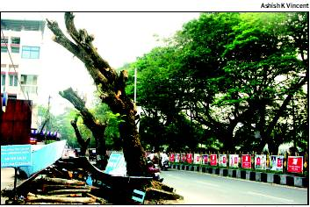
EIA OF KOCHI METRO
Negative environmental impacts
●Negative impacts falls under three categories
►Impact due to project location
►Impact due to project design & construction works
►Impact due to project operation
♦IMPACT DUE TO PROJECT LOCATION
►Change of land use pattern~16 Hecter
►Loss of trees- 477 (total cost -3.5 lakh)
►Project Affected People(PAPs)-for 25km strech 40 Hecter land is required
►Maintenance depot at Muttom-subjected to water logging in monsoon
VJCET VAZHAKULAM

Slide 18
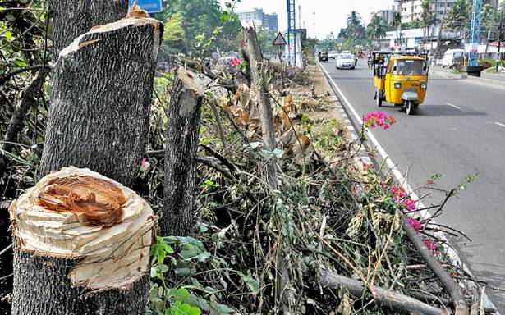
EIA OF KOCHI METRO
♦IMPACT DUE TO PROJECT DESIGN&CONSTRUCTION WORKS
►Soil erosion due to runoff from unprotected excavations
►Dumping of construction spoils leading to surface and ground water pollution
►Traffic diversion was essentially required
►Impact on water quality due to disposal of waste (construction and sanitation)
►Waste generated from metro station-about 4.5T/day when 25% passengers visiting station produces refuse
VJCET VAZHAKULAM

Slide 19
EIA OF KOCHI METRO
♦IMPACTS DUE TO PROJECT OPERATION
►Water pollution-due to oil spillage during cleaning and repair process
►Noise-Due to construction and fabrication activities on construction
phase
-Engine noise,cooling fan noise etc. during operational phase
►At operational phase noise is below 80dBA-which is slightly higher
►Overall ambient noise level-reduction of 10-15% due to reduction in road traffic
►Emergency measures are implemented for accident hazards
VJCET VAZHAKULAM

Slide 20
EIA OF KOCHI METRO
♦IMPACTS DUE TO PROJECT OPERATION (contd.)
►Water supply ▪As per Central Public Health Environmental
Engineering Organisation(CPHEEO) workers at
railway stations requires 45litres/day
▪Water demand for other activities-100m³ per day
▪For fire fighting-Municipal water supply system
►Sanitation ▪Passengers refuse is about 100kg/day
▪Collection bins of capacity 120 litres are placed at key
points in the stations
▪Awareness to produce less refuse for a green metro
VJCET VAZHAKULAM

Slide 21
EIA OF KOCHI METRO
Environmental management plan
●Tree plantation-planting 10 trees for every tree that is felled (477 trees to be cut)
●KMRL planned to plant 8000 trees – 5159 already planted
●Compensation for loss of trees
►Uprootal of 477 trees
►Compensation for loss – Rs 3.5 lakhs
●Water supply and sanitation
►Construction and operation - water supplied from
municipal source
►Sewage generated – disposed off to a combination of
septic tank and soak pit facility
►Solid wastes at stations – disposed off by Kochi
Municipal Co-operation
VJCET VAZHAKULAM

Slide 22
EIA OF KOCHI METRO
●Noise
►Increased noise level in ambient air due to construction and
operation of rail
►But overall noise gets reduced – due to reduction in traffic
►Work shift for people working near high level of noises such as
near engine,vent shafts etc..
►Protective device for workers
●Vibration control
►Ballast less tracks supported on 2 layers of rubber pads reduces
track noise and vibration
►By improving track geometry
►Insertion of shock absorbing pads
●Energy management
►By maximum utilization of natural day light
►Switching to energy efficient luminaries eg.LED&CFL
VJCET VAZHAKULAM

Slide 23
EIA OF KOCHI METRO
Environmental monitoring plan
●For constructional and operational phases
●Parameters monitored
►Water quality
►Air quality
♦WATER QUALITY
●Monitoring plan
►One year before construction
►During construction
►One year after construction
●Monitored atleast four times a year.
●Parameters monitored
►pH
►Total dissolved solids
►Chlorides
►Natural sulphates
●Cost for 4 locations –about Rs 4.00 lakhs
VJCET VAZHAKULAM

Slide 24
EIA OF KOCHI METRO
♦AIR QUALITY & NOISE LEVEL
●Same procedure as water quality
●Total cost for 4 stations – about Rs15.20 lakhs
Proposed monitoring programme air and noise quality
Monitoring | Monitoring parameters | Number of proposed sites | Sampling duration | Frequency | Cost (Rs lakhs)
Ambient air quality | 4 | 4 | Twice a week | Four times a year | 15.00
Noise levels | dB(A) | 4 | Once a week | Seasonal | 0.20
Total cost |  |  |  |  | 15.20
VJCET VAZHAKULAM

Slide 25
EIA OF KOCHI METRO
Disaster management plan
●Developed by KMRL in consultation with District Disaster Management Authority(DDMA).
●Consists of an Emergency Action Committee(EAC) comprising of representatives including home gaurd,station master, fire brigade etc..
●Operating staffs of Kochi Metro – extensively trained for fire fighting.
●Provision of automatic fire water system in key areas
VJCET VAZHAKULAM

Slide 26
EIA OF KOCHI METRO
With and without metro scenario
♦WITHOUT METRO PROJECT SCENARIO
►Increasing vehicle number-Kochi city has the highest no.of vehicles in state.
►Traffic congestion-Kochi city does not have the proper road infrastructure to meet the rise in traffic.
►CDM Smith studies in May 2013 –by 2018 Kochi will have 1.41 million road transport based passengers and an increase to 2.87 million by 2048.
►Concerns on road safety-As per the report ‘Road Accidents in India:2010’ by Ministry of Road Transport and Highways,Kerala is ranked 3rd with 102 accidents per lakh population.
►In 2010 Kochi was ranked 10th on road accident profile among prominent cities
VJCET VAZHAKULAM

Slide 27
EIA OF KOCHI METRO
♦WITH METRO SCENARIO
►Reduced road stress
►Better accessibility to facilities in the influence area
►Economic stimulations in the micro regions of the infrastructure
►Increased business opportunities
►Overall increased mobility
►Facilitating better planning and up-gradation of influence areas
►Improving the image of the city
►Reduction in emission
VJCET VAZHAKULAM

Slide 28
EIA OF KOCHI METRO
conclusion
♦Studies revealed-
►Implementation of Kochi Metro leads to a positive socio-economic
-environmental utility
► There is a clear balance between development and
environmental consideration
►Some irreversible damages are done-but by careful planning
further damages can be mitigated
►Lots of employment opportunities were created
►Eased traffic in one of major citiy of Kerala
VJCET VAZHAKULAM

Slide 29
references
1.KMRL,2011-Detailed Project Report,DMRC
2.SENES- Executive Summary of EIA &EMP for Kochi Metro Rail Project
3.www.kochimetro.org
VJCET VAZHAKULAM

Slide 30
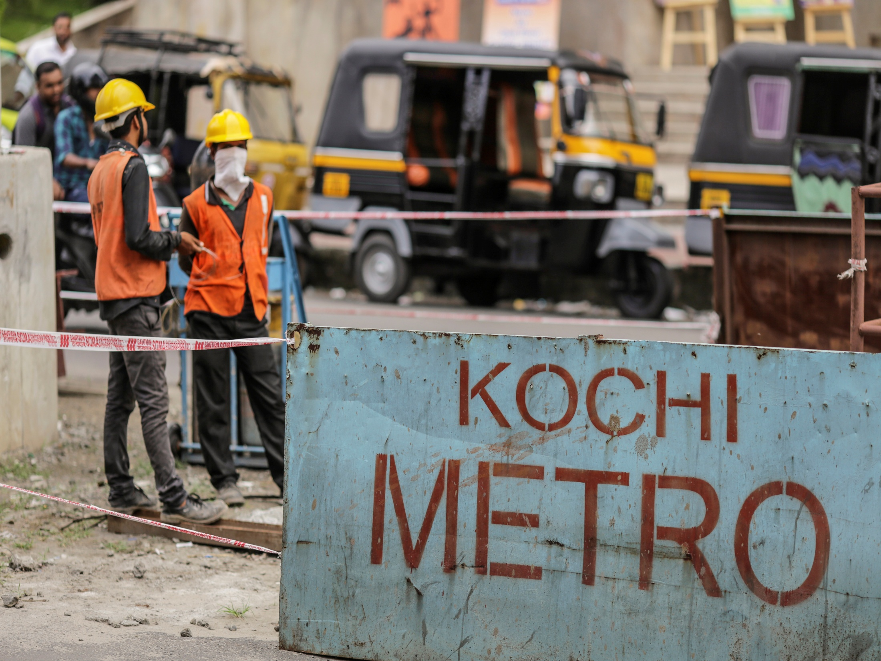
THANK YOU

